Slide 1
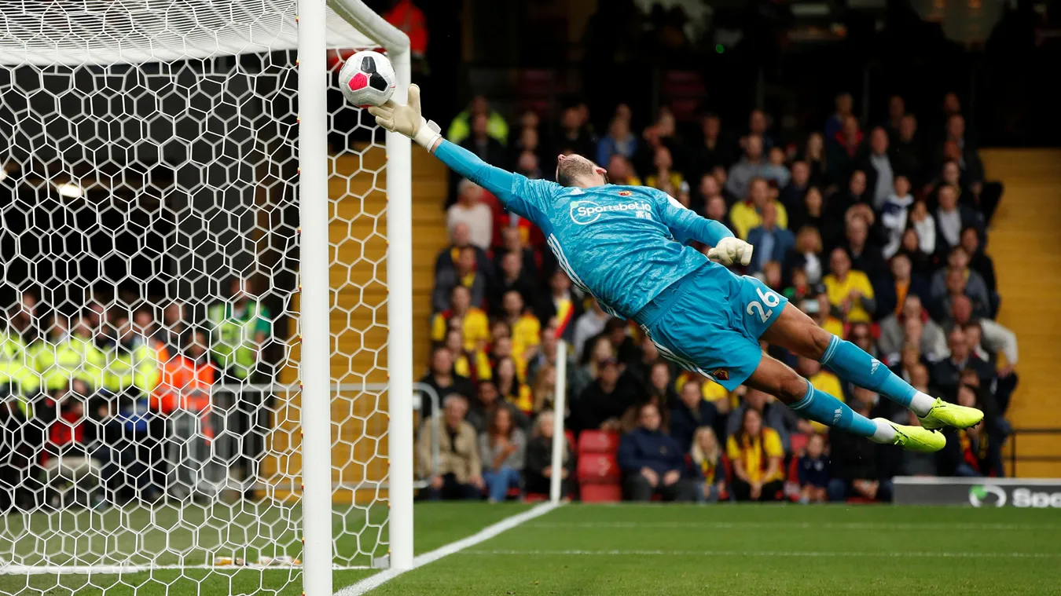
Premier league Predictive Analysis
September 2022

Slide 2
team
Edwin Yu
Parker Jones
Kwasi Sefah
Sam Caslowitz
Trevor Jackson

Slide 3
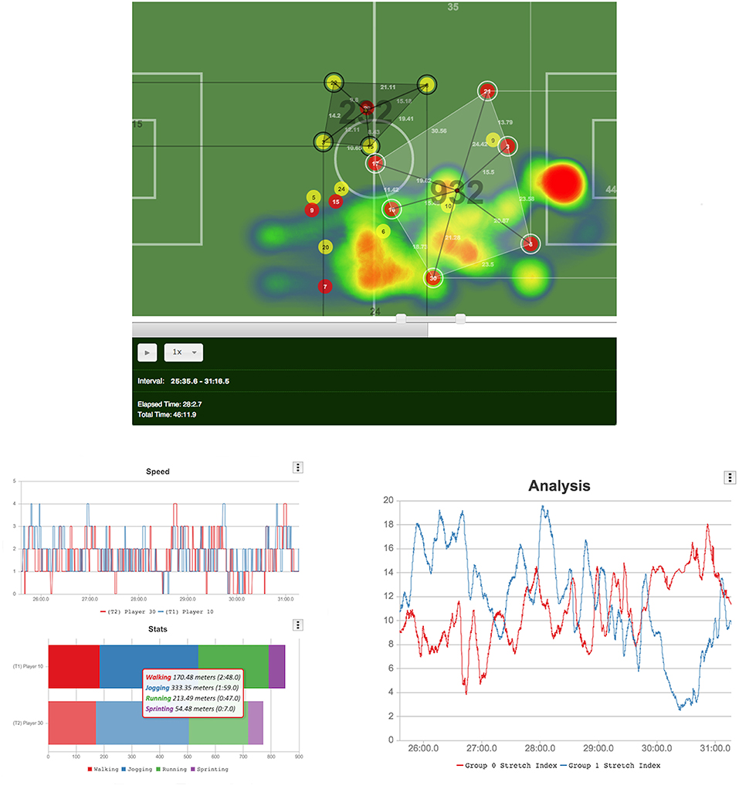
Project Overview
Sports statistics and analytics has been increasingly popular across all sports as analytical tools have become more available and powerful.
Higher volumes and precision of data has become more readily available but the dynamics of team sports has remained the same.
Our goal with this project is to use historical scoring data from the Premier League in English Football (or Soccer) to create predictive models that can influence sports betting, and team decision making.

Slide 4
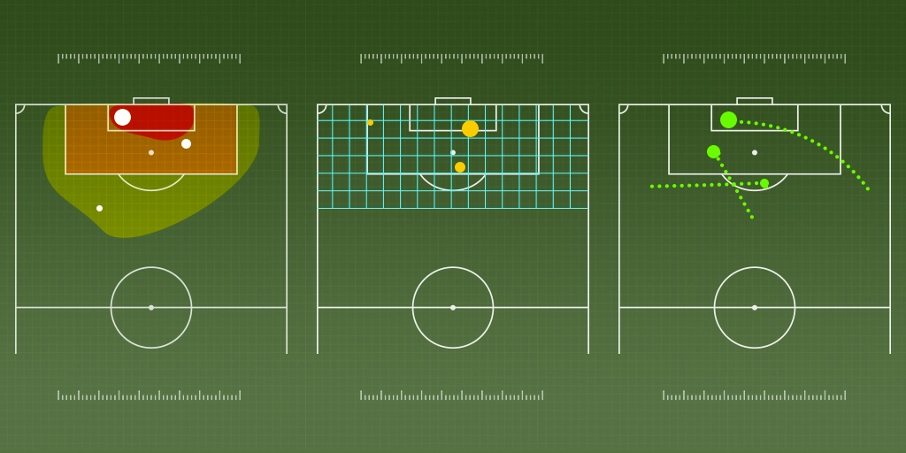
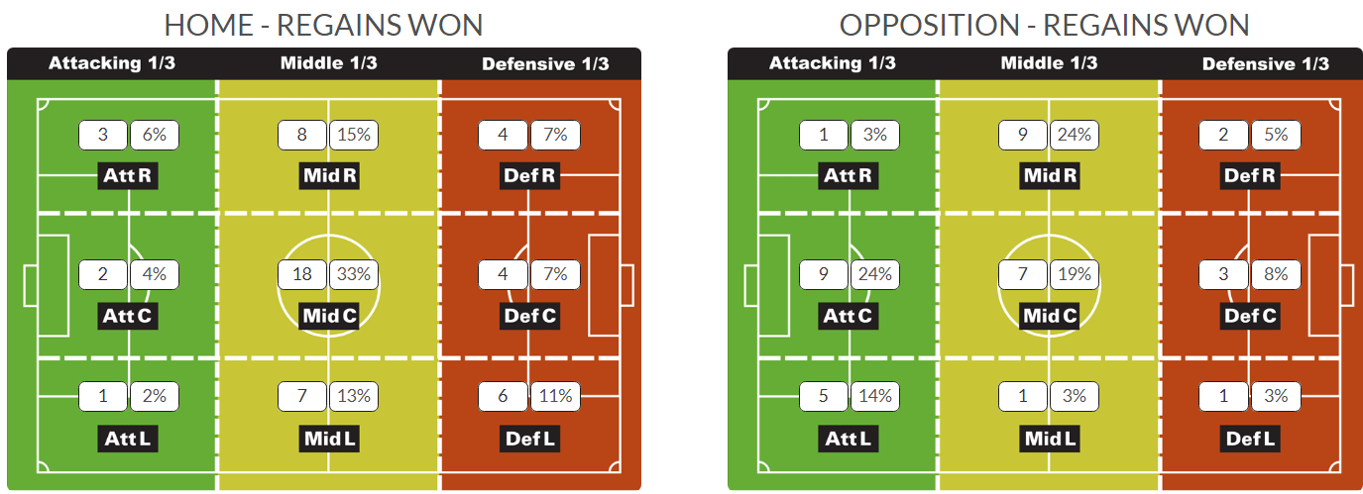
Ideas worth exploring
How does a red card affect the outcome of a game?
Is the home team advantage real?
Is it possible to predict the Ballon D’Or qualifiers?
Do larger contracts win more games?
Can individual players win the World Cup?
What’s the most important variable in determining ticket sales?
How do age and experience affect scoring potential?

Slide 5
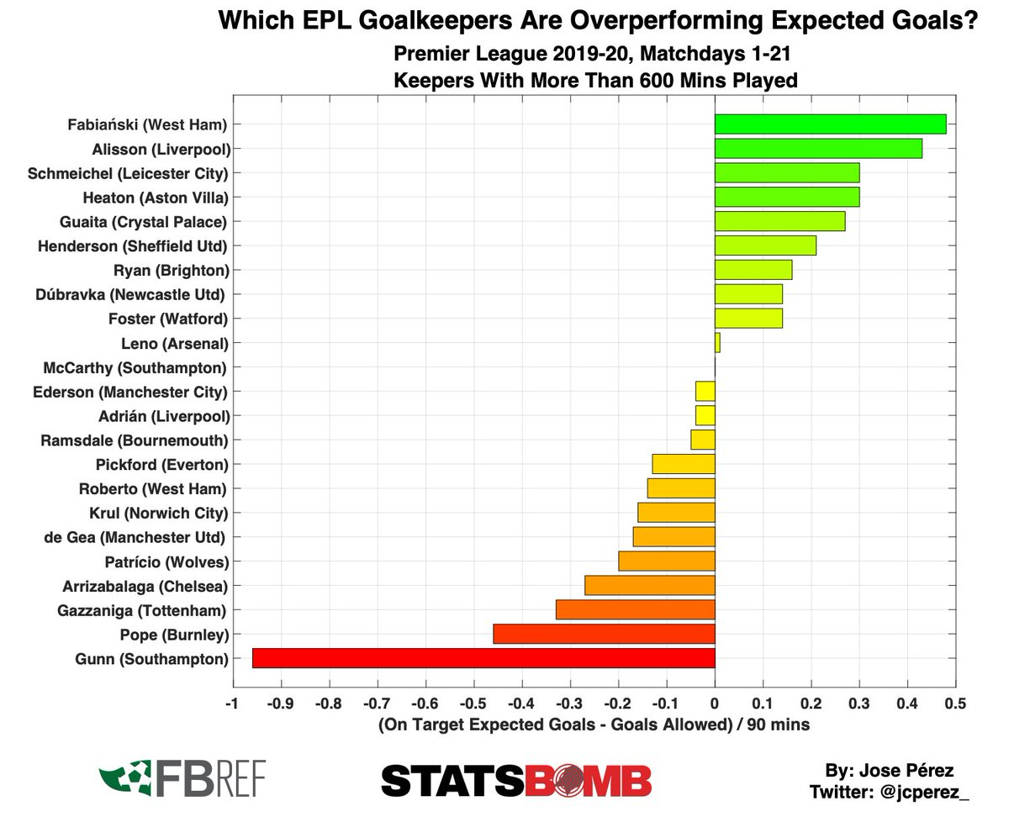
Metrics considered
Total Wins/Losses
Home Wins/Losses/Draws
Away Wins/Losses/Draws
Goal Differential
Goals Scored/Goals For
Goals Allowed/Goals Against
Expected Goals
Expected Goals Against
Player Salary
Yearly Expenditure
Yellow Cards
Red Cards
Fouls
Possession Time
Clean Sheets
Corners
Clearance Off Line
Tools/Libraries Used
SQL
pandas
matplotlib
statsmodels.api
sklearn library:
LinearRegression, datasets, minmaxscaler, rfe, accuracy_score, train_test_split, cross_val_score, RandomForestClassifier

Slide 6
Project objective
Subtitle
Add text, images, art, and videos.
Add transitions, animations, and motion.
Save to OneDrive, to get to your presentations from your computer, tablet, or phone.

Slide 7
Sources and Database
 | Category 1 | Category 2 | Category 3 | Category 4
Item 1 | 4.5 | 2.3 | 1.7 | 5
Item 2 | 3.2 | 5.1 | 4.4 | 3
Item 3 | 2.1 | 1.7 | 2.5 | 2.8
Item 4 | 4.5 | 2.2 | 1.7 | 7

Slide 8
Cleaning and Collating the data
Title
To start a presentation, go to the Slide Show tab, and select From Beginning.
Title
To display Presenter view, in Slide Show view, on the control bar at the bottom left select the three dots, and then Show Presenter View.
Title
During your presentation, the speaker notes are visible on your monitor, but aren't visible to the audience.
Title
The Notes pane is a box that appears below each slide. Tap it to add notes.
Title
If you don’t see the Notes pane or it is completely minimized, click Notes on the task bar across the bottom of the PowerPoint window.

Slide 9
Linear Regressions

Slide 10
Results from the Model
Subtitle
Subtitle
Subtitle
Add text, images, art, and videos.
Add transitions, animations, and motion.
Save to OneDrive, to get to your presentations from your computer, tablet, or phone.
Open the Design Ideas pane for instant slide makeovers.
When we have design ideas, we’ll show them to you right there.
This PowerPoint theme uses its own unique set of colors, fonts, and effects to create the overall look and feel of these slides.
PowerPoint has tons of themes to give your presentation just the right personality.

Slide 11




Challenges
With PowerPoint, you can create presentations and share your work with others, wherever they are. Type the text you want here to get started. You can also add images, art, and videos on this template. Save to OneDrive and access your presentations from your computer, tablet, or phone. ​

Slide 12

Potential Further Analyses
Additional Questions raised by the project.

Slide 13


Thank you
Presenter Name | Email | Website

